Slide 1
Version 2.03
UCSD CSE 30
Computer Organization and Systems Programming
Arm – Part 2
Cao-Slides. Credit: Keith Muller

Slide 2
What is a Bitwise Operation?
a = | a₇ | a₆ | a₅ | a₄ | a₃ | a₂ | a₁ | a₀
 | <op> | <op> | <op> | <op> | <op> | <op> | <op> | <op>
b = | b₇ | b₆ | b₅ | b₄ | b₃ | b₂ | b₁ | b₀
result = | c₇ | c₆ | c₅ | c₄ | c₃ | c₂ | c₁ | c₀
Bitwise operators are applied independently to each of the corresponding bit positions in each variable
Each bit position of the result depends only on bits in the same bit position within the operands
x

Slide 3

Bitwise (Bit to Bit) Operators in C
output = ~a;
output = a & b;
output = a | b;
output = a ^ b; //EOR
a | ~a
0 | 1
1 | 0
a | b | a & b
0 | 0 | 0
0 | 1 | 0
1 | 0 | 0
1 | 1 | 1
a | b | a | b
0 | 0 | 0
0 | 1 | 1
1 | 0 | 1
1 | 1 | 1
a | b | a ^ b
0 | 0 | 0
0 | 1 | 1
1 | 0 | 1
1 | 1 | 0
& with 1 to let a bit through
& with 0 to set a bit to 0
| with 1 to set a bit to 1
| with 0 to let a bit through
^ with 1 will flip the bit
^ with 0 to let a bit through
Bitwise
NOT
Bitwise
AND
Bitwise
OR
Bitwise
EOR
~ 1100
----
0011
0110
& 1100
----
0100
0110
| 1100
----
1110
0110
^ 1100
----
1010
x

Slide 4

Bitwise Not (vs Boolean Not)
Bitwise NOT
a | ~a
0 | 1
1 | 0
~ 1100
----
0011
in C
int output = ~a;
 | Bitwise Not
number | 0101 1010 0101 1010 1111 0000 1001 0110
~number | 1010 0101 1010 0101 0000 1111 0110 1001
Meaning | Operator | Operator | Meaning
Boolean NOT | !b | ~b | Bitwise NOT
Boolean operators act on the entire value not the individual bits
Type | Operation | result
bitwise | ~0x01 | 1111 1111 1111 1111 1111 1111 1111 1110
Boolean | !0x01 | 0000 0000 0000 0000 0000 0000 0000 0000
x

Slide 5
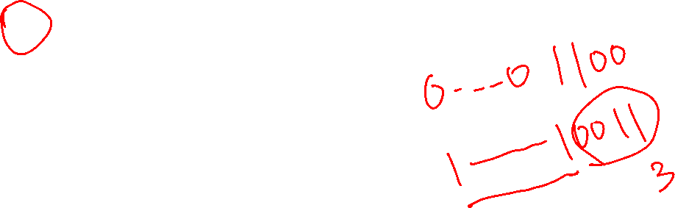
MVN (not)
mvn r0, r1
// Copies all 32 bits
// of the value held
// in register r1 into
// the register r0
// then does a bitwise NOT
register r1
Bitwise NOT
~ 1100
----
0011
register r0
A bitwise NOT operation
0x 0c
mvn r0, 12
// Expands an imm8 value 0x0c
// stored in the instruction
// into a register then does
// a bitwise NOT
0x0c
imm8 expansion
0x0000000c
bitwise not
register r0
0xffff fff3
0xfffffff3
x

Slide 6
mvn – Copies NOT (~)
mvn
Rd
rot4
imm8
mvn
Rd
Rm
destination register
constant (immediate value)
destination register
source register
~ 1100
----
0011
mvn Rd, constant // Rd = constant
mvn Rd, Rm // Rd = Rm
Bitwise NOT
bitwise NOT operation. Immediate (constant) version copies to 32-bit register, then does a bitwise NOT
mvn r1, 4 // x = ~4
mvn r1, r5 // x = ~y in C
mvn r1, 0 // x = -1
imm8 | extended imm8 | inverted imm8 | signed base 10
0x00 | 0x00 00 00 00 | 0xff ff ff ff | -1
0xff | 0x00 00 00 ff | 0xff ff ff 00 | -256
invert the bits
copy into 32 bits zero extend
r1
0xfffffffb
0x00000004
0x4
r1
0x55555555
0xaaaaaaaa
r5
r1
0x11111111
0x0
x

Slide 7
Bitwise Instructions
<op>
Rd
Rn
rot4
imm8
<op>
Rd
Rn
Rm
destination
operand 1
Operand 2 constant
destination
operand 1
Operand 2
<op> Rd, Rn, constant // Rd = Rn <op> constant
<op> Rd, constant // Rd = Rd <op> constant
<op> Rd, Rn, Rm // Rd = Rn <op> Rm
Bytes: 0 <= imm8 <= 255 + values from "rotating" rot 4 bits
Bitwise <op> description | C Syntax | Arm <op> Syntax Op2: either register or constant value | Operation
Bitwise AND | a & b | and R_{d}, R_{n}, Op2 | R_{d} = R_{n} & Op2
Bitwise OR | a | b | orr R_{d}, R_{n}, Op2 | R_{d} = R_{n} | Op2
Exclusive OR | a ^ b | eor R_{d}, R_{n}, Op2 | R_{d} = R_{n} ^ Op2
Bitwise NOT | a = ~b | mvn R_{d}, R_{n} | R_{d} = ~R_{n}
x

Slide 8
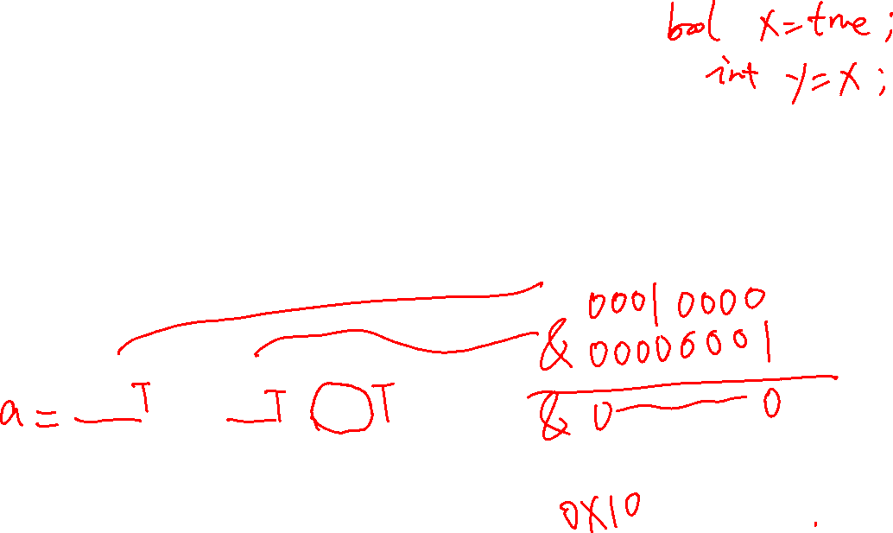
Bitwise versus C Boolean Operators
Boolean Operators
Bitwise Operators
Meaning | Operator |  | Operator | Meaning
Boolean AND | a && b |  | a & b | Bitwise AND
Boolean OR | a || b |  | a | b | Bitwise OR
Boolean NOT | !b |  | ~b | Bitwise NOT
Boolean operators act on the entire value not the individual bits
bitwise & versus boolean &&
0x10 & 0x01 = 0x00 (bitwise)
0x10 && 0x01 = 0x01 (Boolean)
bitwise ~ versus boolean !
~0x01 = 0xfffffffe (bitwise)
!0x01 = 0x0 (Booelan)
x

Slide 9
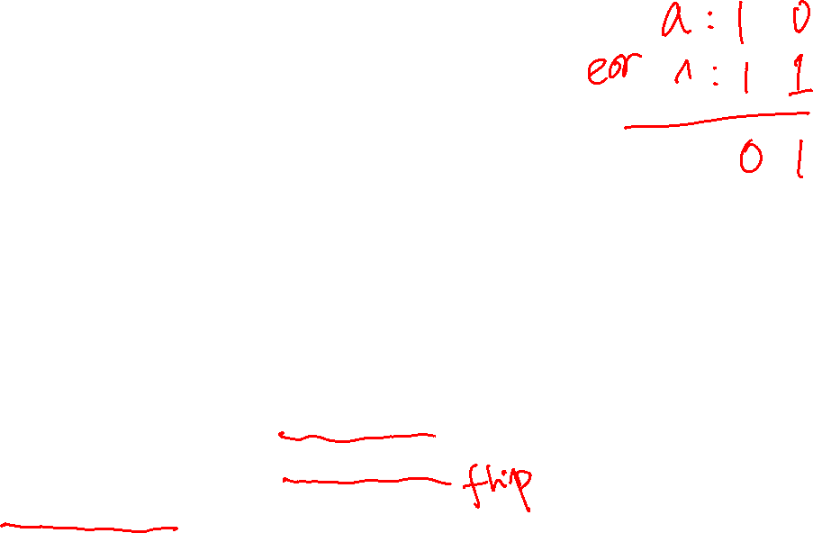
The act (operation) of Masking
Bit masks access/modify specific bits in memory
Masking act of applying a mask to a value with a specific op:
orr: 0 passes bit unchanged, 1 sets bit to 1 (a = b | c; // in C)
eor: 0 passes bit unchanged, 1 inverts the bit (a = b ^ c; // in C)
and: 0 clears the bit, 1 passes bit unchanged (a = b & c; // in C)
a = | a₇ | a₆ | a₅ | a₄ | a₃ | a₂ | a₁ | a₀
 | <op> | <op> | <op> | <op> | <op> | <op> | <op> | <op>
b = | b₇ | b₆ | b₅ | b₄ | b₃ | b₂ | b₁ | b₀
result = | c₇ | c₆ | c₅ | c₄ | c₃ | c₂ | c₁ | c₀
x

Slide 10
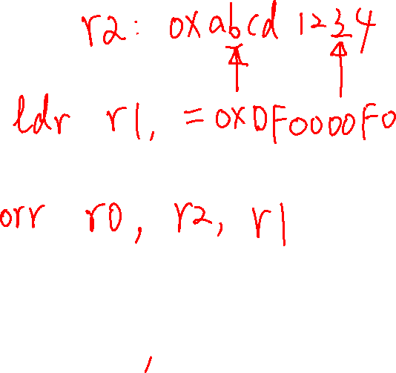
Mask on
force bits to 1 "mask on" operation
1 to set a bit to 1
0 to let a bit through unchanged
orr r1, r2, r3
r1 = r2 | r3; // in C
Example: force lower 16 bits to 1
DATA: r2 0xab ab ab 77
orr
MASK: r3 0x00 00 ff ff
RSLT: r1 0xab ab ff ff
Example: force lower 8 bits to 1
DATA: r2 0xab ab ab 77
orr r1 r2, 0xff
r1 = r2 | 0xff; // in C
RSLT: r1 0xab ab ff ff
unchanged
forces to a 1
x

Slide 11
Mask off
force bits to 0 "mask off" operation
0 to set a bit to 0 ("clears the bit")
1 to let a bit through unchanged
and r1, r2, r3
r1 = r2 & r3; // in C
Example: force lower 8 bits to 0
DATA: r2 0xab ab ab 77
and
MASK: r3 0xff ff ff 00
RSLT: r1 0xab ab ab 00
Example: force lower 8 bits to 0
DATA: r2 0xab ab ab 77
and r1 r2, 0xffffff00
r1 = r2 & 0xffffff00; // in C
RSLT: r1 0xab ab ab 00
unchanged
forces to a 0
x

Slide 12
Extracting (Isolate) a Field of Bits with a mask
extract top 8 bits of r2 into r1
0 to set a bit to 0 ("clears the bit")
1 to let a bit through unchanged
and r1, r2, r3
DATA: r2 0xab ab ab 77
and
MASK: r3 0xff 00 00 00
RSLT: r1 0xab 00 00 00
extract top 8 bits of r2 into r1
DATA: r2 0xab ab ab 77
and r1, r2, 0xff000000
RSLT: r1 0xab 00 00 00
r1 = r2 & 0xff000000; // in C
unchanged
forces to a 0
x

Slide 13

Finding if a bit is set
query the status of a bit "bit status" operation
0 to set a bit to 0 ("clears the bit")
1 to let a bit through unchanged
and r1, r2, 0x02
cmp r1, 0
beq .Lendif
// code for is set
.Lendif:
Example is bit 1 set
DATA: r2 0xab ab ab 77
and
MASK: 0x00 00 00 02 is bit 1 set?
RSLT: r1 0x00 00 00 02 != 0 if set
forces to a 0
unchanged
unsigned int r1, r2;
// code
r1 = r2 & 0x02
if (r1 != 0) {
// code for is set
}
unsigned int r2;
// code
if ((r2 & 0x02) != 0) {
// code for is set
}
x

Slide 14
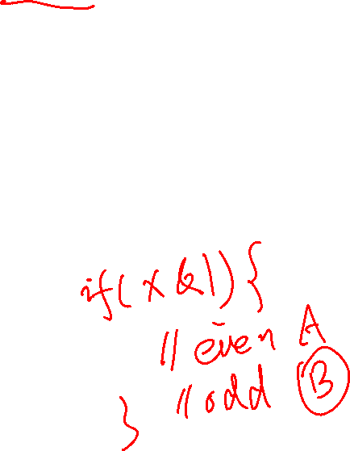
Even/Odd
Even or odd, check LSB (same as mod %2)
check LSB (bit 0) if set then odd, else even
and r1, r2, 0x01
cmp r1, 0x01
bne .Lendif
// code for handling odd numbers
.Lendif:
DATA: r2 0xab ab ab 77
and
MASK: r3 0x00 00 00 01 (mod 2 even or odd)
RSLT: r1 0x00 00 00 01 (odd)
unsigned int r2;
// code
if ((r2 & 0x01) != 0) {
// code for handling odd numbers
}
forces to a 0
unchanged
x

Slide 15
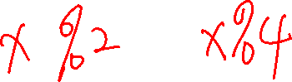
MOD %<power of 2>
Example: %2
DATA: r2 0xab ab ab 77
and
MASK: r3 0x00 00 00 01 (mod 2 even or odd)
RSLT: r1 0x00 00 00 01 (odd)
forces to a 0
unchanged
remainder (mod): num % d where num ≥ 0 and d = 2^{k}
mask = 2^{k} -1 so for mod 16, mask = 16 -1 = 15
and r1, r2, r3
Example: Mod 16
DATA: r2 0xab ab ab 77
and
MASK: r3 0x00 00 00 0f (mod 16)
RSLT: r1 0x00 00 00 07
forces to a 0
unchanged
x

Slide 16
Flipping bits: bit toggle Used in PA7/PA8
Example: invert (flip) the lower 8-bits
DATA: r2 0xab ab ab 77
eor
MASK: r3 0x00 00 00 ff
RSLT: r1 0xab ab ab 88
77: 0111 0111
invert (flip) bits "bit toggle" operation
1 will flip the bit
0 to let a bit through
eor r1, r2, r3
Observation: When applied twice, it returns the original value (symmetric encoding)
With a mask of all 1's is a 1's compliment
unchanged
inverts (flips)
88: 1000 1000
DATA: r1 0xab ab ab 88
eor
MASK: r3 0x00 00 00 ff apply a 2nd time
RSLT: r1 0xab ab ab 77 original value!
Example: flip the lower 8-bits
eor r1, r2, 0xff
inverts (flips)
unsigned int r1, r2;
r1 = r2 ^ 0xff;
x

Slide 17
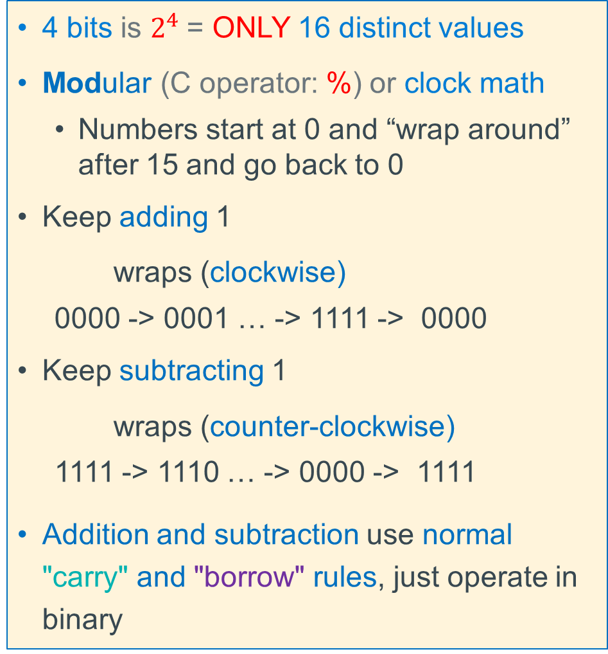
Unsigned Integers (positive numbers) with Fixed # of Bits
4 bits is $2^{4}$= ONLY 16 distinct values
Modular (C operator: %) or clock math
Numbers start at 0 and “wrap around” after 15 and go back to 0
Keep adding 1
wraps (clockwise)
0000 -> 0001 … -> 1111 -> 0000
Keep subtracting 1
wraps (counter-clockwise)
1111 -> 1110 … -> 0000 -> 1111
Addition and subtraction use normal "carry" and "borrow" rules, just operate in binary
x

Slide 18

Problem: How to Encode Both Positive and Negative Integers
How do we represent the negative numbers within a fixed number of bits?
Allocate some bit patterns to negative and others to positive numbers (and zero)
$2^{n}$ distinct bit patterns to encode positive and negative values
Unsigned values: 0 ... $2^{n}$–1
Signed values: $−2^{n−1}$ … $2^{n−1}$–1 (dividing the range in ~ half including 0)
On a number line (below): 8-bit integers – signed and unsigned (e.g., char in C)
-1 comes from counting 0 as a "positive" number
$$0$$
Unsigned
$+2^{8}$-1
-$∞$
+$∞$
$$−128$$
$$0$$
$$+127$$
$$+255$$
$${−2}^{8−1}$$
$$0$$
Signed
${+2}^{8−1}$-1
Same “width” (same number of encodings), just shifted in value
x

Slide 19
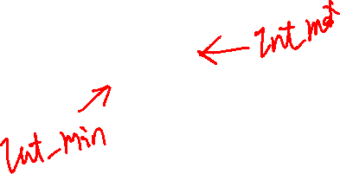
Two’s Complement: The MSB Has a Negative Weight
$$2^{′}s Comp={{−b}_{n−1}2}^{n−1}+ {b_{n−2}2}^{n−2}+ …+ {b_{1}2}^{1}+ b_{0}2^{0}$$
$b_{n−1}$ weight is $(−2^{n−1}$), all other bits: have positive weights $(+2^{i}$)
b_{n-1}
b_{n-2}
. . .
b₀
4-bit (w = 4) weight = $−2^{4−1}$ = -2³ = -8
1010₂ unsigned: 1x2³ + 0x2² + 1x2¹ + 0x2⁰ = 10
1010₂ two’s complement: -1x2³ + 0x2² + 1x2¹ + 0x2⁰ = -8 + 2 = –6
-8 in two’s complement: 1000₂ = -2³ + 0 = -8
-1 in two’s complement: 1111₂ = -2³ + (2³ – 1) = -8 + 7 = -1
x

Slide 20
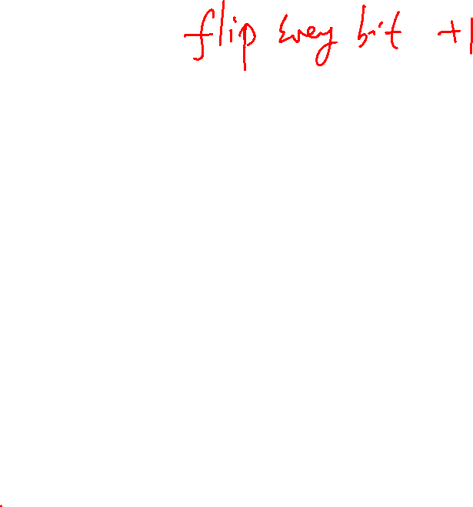
2's Complement Signed Integer Method
Positive numbers encoded same as unsigned numbers
All negative values have a one in the leftmost bit
All positive values have a zero in the leftmost bit
This implies that 0 is a positive value
Only one zero
For n bits, Number range is${ −(2}^{n−1}$) to ${ +(2}^{n−1}$ - 1)
Negative values “go 1 further” than the positive values
Example: the range for 8 bits: -128, -127, .. 0, .. 126, +127
Example the range for 32 bits: -2147483648 .. 0, .. +2147483647
Arithmetic is the same as with unsigned binary!
x

Slide 21
Sign Extension (how type promotion works)
Sometimes you need to work with integers encoded with different number of bits
8 bits (char) -> (16 bits) short -> (32 bits) int
Sign extension increases the number of bits: $n$-bit wide signed integer $X$, EXPANDS to a wider n$\text{−}\text{bit}$ + $k$-bit signed integer $X′$ where both have the same value
Unsigned
Just add leading zeroes to the left side
Two’s Complement Signed:
If positive, add leading zeroes on the left
Observe: Positive stay positive
If negative, add leading ones on the left
Observe: Negative stays negative
n$−bits$
$X$
• • •
• • •
$$Xʹ$$
• • •
• • •
$k$ copies of MSB
original $X \text{n}\text{−}\text{bits}$
x

Slide 22
Example: Two’s Complement Sign or bit Extension - 1
Adding 0's in front of a positive numbers does not change its value
7 = 0111
extend to
8 bits
00000111
Number is still 7
1 = 0001
extend to
8 bits
00000001
Number is still 1
x

Slide 23
Example: Two’s Complement Sign or bit Extension -2
Adding 1's if front of a negative number does not change its value
7 = 0111
invert = 1000
add 1 + 1
-7 1001
-7 = 1001
extend to
8 bits
11111001
1001 = -8 + 1 = -7
11111001 =
(-128 + 64 + 32 + 16 + 8) + 1 = -8 + 1 = -7
7 = 00000111
invert = 11111000
add 1 + 1
-7 11111001
x

Slide 24
Sign Extension in C: Type casts
Convert from smaller to larger integral data types
C and Java automatically performs sign extension
Example (on pi-cluster with 32-bit int)
#include <stdlib.h>
#include <stdio.h>
int main(void)
{
signed char c = -1;
signed int i = c;
unsigned char d = 1;
unsigned int j = d;
printf("c decimal = %hd\n", c);
printf("c = 0x%hhx\n", c);
printf("i decimal = %d\n", i);
printf("i = 0x%x\n", i);
printf("\nd decimal = %hd\n", d);
printf("d = 0x%hhx\n", d);
printf("j decimal = %d\n", j);
printf("j = 0x%x\n", j);
return EXIT_SUCCESS;
}
%./a.out
c decimal = -1
c = 0xff
i decimal = -1
i = 0xffffffff
d decimal = 1
d = 0x1
j decimal = 1
j = 0x1
x

Slide 25
Different Type of Numbers each have a Fixed # of Bits Spanning one or more contiguous bytes of memory
C Data Type | AArch-32 contiguous Bytes
char (arm unsigned) | 1
short int | 2
unsigned short int | 2
int | 4
unsigned int | 4
long int | 4
long long int | 8
float | 4
double | 8
long double | 8
pointer * | 4
Byte 8-bit integer uses 1 byte
00000000
7
0
Half Word 16-bit integer uses 2 bytes
000000001
00000000
15
7
0
most significant bit (largest power of 2)
least significant byte
Word 32-bit integer uses 4 bytes
00000011
00000010
00000001
00000000
31
0
least significant bit (smallest power of 2)
most significant byte
x

Slide 26
Byte Ordering of Numbers In Memory: Endianness
Two different ways to place multi-byte integers in a byte addressable memory
Big-endian: Most Significant Byte (“big end”) starts at the lowest (starting) address
Little-endian: Least Significant Byte (“little end”) starts at the lowest (starting) address
Example: 32-bit integer with 4-byte data
Little-Endian
Big-Endian
a1
b2
c3
d4
23
0x103
23
0x103
d4
a1
01
0x102
01
0x102
c3
MSB
Most significant byte
LSB
Least significant byte
b2
c3
0x101
b2
0x101
d4
0x100
a1
0x100
x

Slide 27
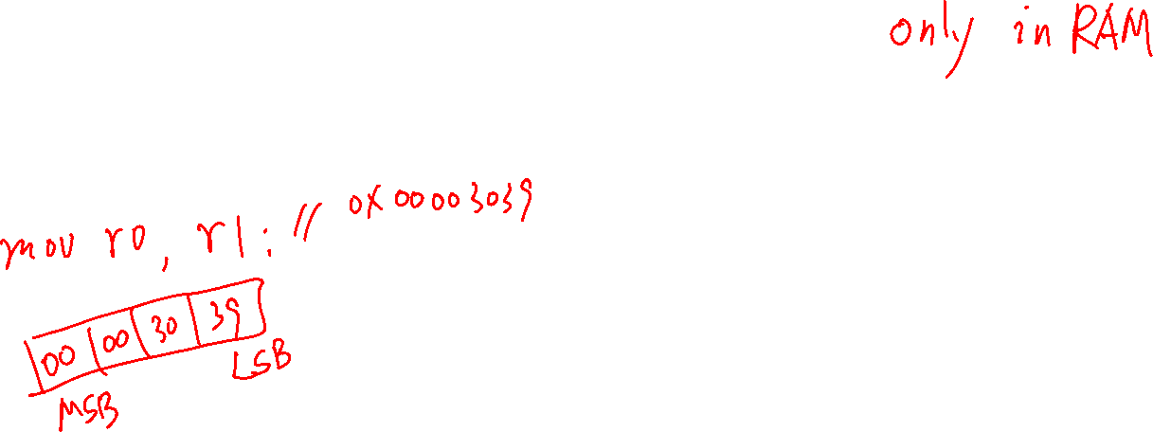
Byte Ordering Example
Decimal: 12345
Binary: 0011 0000 0011 1001
Hex: 3 0 3 9
int x = 12345;
// or x = 0x00003039; // show all 32 bits
(big-endian)
IA32, ARM32 (little-endian)
0x03
39
00
0x03
0x02
30
00
0x02
0x01
00
30
0x01
0x00
00
39
0x00
x

Slide 28
Byte Addressable Memory Shown as 32-bit words
1 byte Memory Content
One byte per row
Contents of Memory
One 32-bit (4 byte) word per row
Byte
Memory
Address
Word
Memory
Address
0x07
0x12345687
MSByte
LSByte
0x06
0x12345686
1 32-bit
(4 byte) word
0x1234568c
0x05
0x12345685
Word Aligned address
0x04
0x12345684
0x12345688
0x03
0x12345683
0x07
0x06
0x05
0x04
0x12345684
0x02
0x12345682
0x03
0x02
0x01
0x00
0x12345680
1 32-bit
(4 byte) word
0x01
0x12345681
Word Aligned address
0x12345683
0x12345682
0x12345681
0x12345680
0x00
0x12345680
Byte address
Observation
32-bit aligned addresses
rightmost 2 bits of the address are always 0
x

Slide 29
Using pointers to examine byte order (on pi-cluster)
kmuller@keithm-pi4:~$ ./a.out
foo[1]: aabbccdd
foo[0]: 11223344
byte 7: aa
byte 6: bb
byte 5: cc
byte 4: dd
byte 3: 11
byte 2: 22
byte 1: 33
byte 0: 44
#include <stdio.h>
#define SZ 2
int main()
{
unsigned int foo[SZ] = {0x11223344, 0xaabbccdd};
unsigned int *iptr = foo;
unsigned char *chptr = (unsigned char *)foo;
for (int i = SZ-1; i >= 0; i--)
printf("foo[%d]: %x\n", i, *(iptr + i));
for (int i = sizeof(foo)-1; i >= 0; i--)
printf("byte %d: %x\n", i, (unsigned int)*(chptr + i));
return 0;
}
0xaa
0x12345687
0xbb
0x12345686
0xcc
0x12345685
0xdd
0x12345684
0x11
0x12345683
0x22
0x12345682
0x33
0x12345681
0x44
0x12345680
x

Slide 30
Shift and Rotate Instructions
<inst>
Rd
Rm
const5
<inst>
Rd
Rm
Rs
destination
operand 1
operand 2 constant
destination
operand 1
operand 2
Number of bit to shift or rotate: const 5 bits
Number of bit to shift or rotate: Rs
Instruction | Syntax | Operation | Notes | Diagram
Logical Shift Left int x; or unsigned int x x << n; | lsl R_{d}, R_{m}, const5 lsl R_{d}, R_{m}, R_{s} | R_{d} ← R_{m} << const5 R_{d} ← R_{m} << R_{s} | Zero fills shift: 0 - 31
Logical Shift Right unsigned int x; x >> n; | lsr R_{d}, R_{m}, const5 lsr R_{d}, R_{m}, R_{s} | R_{d} ← R_{m} >> const5 R_{d} ← R_{m} >> R_{s} | Zero fills shift: 1 – 32
Arithmetic Shift Right int x; x >> n; | asr R_{d}, R_{m}, const5 asr R_{d}, R_{m}, R_{s} | R_{d} ← R_{m} >> const5 R_{d} ← R_{m} >> R_{s} | Sign extends shift: 1 - 32
Rotate Right unsigned int x; x = (x>>n)|(x<<(32-n)); | ror R_{d}, R_{m}, const5 ror R_{d}, R_{m}, R_{s} | R_{d} ← R_{m} ror const5 R_{d} ← R_{m} ror R_{s} | right rotate rot: 0 - 31
x

Slide 31
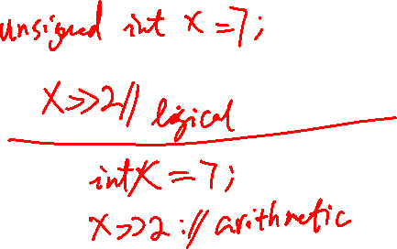
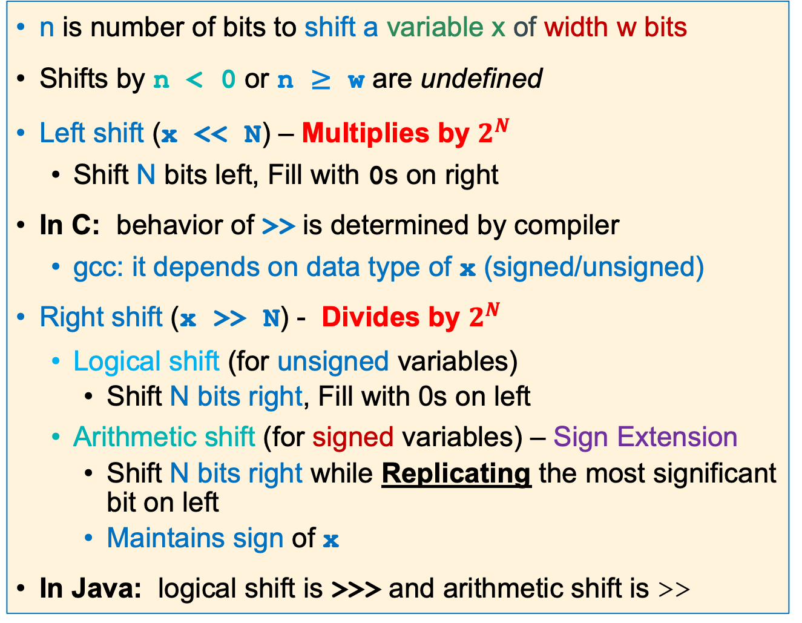
Shift Operations in C
n is number of bits to shift a variable x of width w bits
Shifts by n < 0 or n ≥ w are undefined
Left shift (x << N) – Multiplies by $2^{N}$
Shift N bits left, Fill with 0s on right
In C: behavior of >> is determined by compiler
gcc: it depends on data type of x (signed/unsigned)
Right shift (x >> N) - Divides by $2^{N}$
Logical shift (for unsigned variables)
Shift N bits right, Fill with 0s on left
Arithmetic shift (for signed variables) – Sign Extension
Shift N bits right while Replicating the most significant bit on left
Maintains sign of x
In Java: logical shift is >>> and arithmetic shift is >>
Left Shift
Right logical Shift
Right Arithmetic Shift
x

Slide 32
Arithmetic Shift Right Example: Testing Sign
asr r2, r0, 31
r0 0xab ab ab 77 // bit 31 is a one
r2 0xff ff ff ff // see the sign extend
Test for sign
-1 if r0 negative
int i;
//code
if ((i>>31) == -1) {
// code neg #
}
asr r2, r0, 31
cmp r2, -1
bne .Lendif
//code neg #
.Lendif:
x

Slide 33
Arithmetic Shift Right Example: Testing SIgn
asr r2, r0, 31
r0 0x7b ab ab 77 // bit 31 is a zero
r2 0x00 00 00 00 // see the sign extend
Test for sign
0 if r0 positive
int i;
//code
if ((i>>31) == 0) {
// code pos #
}
asr r2, r0, 31
cmp r2, 0
bne .Lendif
//code positive #
.Lendif:
x

Slide 34
Logical Shift & Rotate Operations
lsr r2, r0, 8
r0 0xab ab ab 77
r2 0x00 ab ab ab
lsl r2, r0, 8
r0 0xab ab ab 77
r2 0xab ab 77 00
ror r2, r0, 8
r0 0xab ab ab 77
r2 0x77 ab ab ab
x

Slide 35
Extracting/Isolating Unsigned Bitfields
Move byte 2 in r0 to byte 0 in r1
Hint: Useful for PA7
31 |  |  |  |  |  |  | 24 | 23 |  |  |  |  |  |  | 16 | 15 |  |  |  |  |  |  | 8 | 7 |  |  |  |  |  |  | 0
 |  |  |  |  |  |  |  | 1 | 0 | 1 | 0 | 1 | 0 | 1 | 0
byte 3
byte 2
byte 1
byte 0
r0
next shift left = 8
pushed bits to far left
31 |  |  |  |  |  |  | 24 | 23 |  |  |  |  |  |  | 16 | 15 |  |  |  |  |  |  | 8 | 7 |  |  |  |  |  |  | 0
1 | 0 | 1 | 0 | 1 | 0 | 1 | 0 |  |  |  |  |  |  |  |  |  |  |  |  |  |  |  |  | 0 | 0 | 0 | 0 | 0 | 0 | 0 | 0
byte 3
byte 2
byte 1
byte 0
lsl r1, r0, 8
unsigned int r0,r1;
r1 = r0 << 8;
r1
Next shift right = 24
pushed bits to far right
31 |  |  |  |  |  |  | 24 | 23 |  |  |  |  |  |  | 16 | 15 |  |  |  |  |  |  | 8 | 7 |  |  |  |  |  |  | 0
0 | 0 | 0 | 0 | 0 | 0 | 0 | 0 | 0 | 0 | 0 | 0 | 0 | 0 | 0 | 0 | 0 | 0 | 0 | 0 | 0 | 0 | 0 | 0 | 1 | 0 | 1 | 0 | 1 | 0 | 1 | 0
byte 3
byte 2
byte 1
byte 0
lsr r1, r1, 24
r1 = r1 >> 24;
r1
unsigned zero-extension (all 0’s)
Extracted bit-field
x

Slide 36
Extracting Signed Bitfields
Move byte 2 in r0 to byte 0 in r1
31 |  |  |  |  |  |  | 24 | 23 |  |  |  |  |  |  | 16 | 15 |  |  |  |  |  |  | 8 | 7 |  |  |  |  |  |  | 0
 |  |  |  |  |  |  |  | 1 | 0 | 1 | 0 | 1 | 0 | 1 | 0
byte 3
byte 2
byte 1
byte 0
r0
next shift left = 8
pushed bits to far left
31 |  |  |  |  |  |  | 24 | 23 |  |  |  |  |  |  | 16 | 15 |  |  |  |  |  |  | 8 | 7 |  |  |  |  |  |  | 0
1 | 0 | 1 | 0 | 1 | 0 | 1 | 0 |  |  |  |  |  |  |  |  |  |  |  |  |  |  |  |  | 0 | 0 | 0 | 0 | 0 | 0 | 0 | 0
byte 3
byte 2
byte 1
byte 0
lsl r1, r0, 8
int r0,r1;
r1 = r0 << 8;
r1
next shift right = 24
31 |  |  |  |  |  |  | 24 | 23 |  |  |  |  |  |  | 16 | 15 |  |  |  |  |  |  | 8 | 7 |  |  |  |  |  |  | 0
1 | 1 | 1 | 1 | 1 | 1 | 1 | 1 | 1 | 1 | 1 | 1 | 1 | 1 | 1 | 1 | 1 | 1 | 1 | 1 | 1 | 1 | 1 | 1 | 1 | 0 | 1 | 0 | 1 | 0 | 1 | 0
pushed bits to far right
byte 3
byte 2
byte 1
byte 0
asr r1, r1, 24
r1 = r1 >> 24;
r1
signed extend (all 1’s)
Extracted
bit-field
x

Slide 37
Inserting Bitfields – Inserting Source Field into Destination Field
31 |  |  |  |  |  |  |  |  |  |  |  |  |  |  |  |  |  |  |  |  |  | 8 | 7 |  |  |  |  |  |  |  | 0
other bits |  |  |  |  |  |  |  |  |  |  |  |  |  |  |  |  |  |  |  |  |  |  | source
Task: Insert source into destination
r0
31 |  |  |  |  |  |  | 24 | 23 |  |  |  |  |  |  |  | 16 | 1 5 |  |  |  |  |  |  |  |  |  |  |  |  |  | 0
do not change |  |  |  |  |  |  |  | destination |  |  |  |  |  |  |  |  | do not change
a | b | a | b
0 | 0 | 0
0 | 1 | 1
1 | 0 | 1
1 | 1 | 1
r1
31 |  |  |  |  |  |  | 24 | 23 |  |  |  |  |  |  |  | 16 | 1 5 |  |  |  |  |  |  |  |  |  |  |  |  |  | 0
all zero's |  |  |  |  |  |  |  | source |  |  |  |  |  |  |  |  | all zero's
Approach
(1) isolate source field
(2) clear destination field
(3) Bitwise or together
r2
31 |  |  |  |  |  |  | 24 | 23 |  |  |  |  |  |  |  | 16 | 1 5 |  |  |  |  |  |  |  |  |  |  |  |  |  | 0
do not change |  |  |  |  |  |  |  | all zeros |  |  |  |  |  |  |  |  | do not change
orr r1, r1, r2
r1 = r1 | r2;
r1
results in
31 |  |  |  |  |  |  | 24 | 23 |  |  |  |  |  |  |  | 16 | 1 5 |  |  |  |  |  |  |  |  |  |  |  |  |  | 0
do not change |  |  |  |  |  |  |  | source |  |  |  |  |  |  |  |  | do not change
r1
x

Slide 38
Inserting Bitfields – Isolating the Source Field
31 |  |  |  |  |  |  |  |  |  |  |  |  |  |  |  |  |  |  |  |  |  | 8 | 7 |  |  |  |  |  |  |  | 0
other bits |  |  |  |  |  |  |  |  |  |  |  |  |  |  |  |  |  |  |  |  |  |  | source
r0
31 |  |  |  |  |  |  | 24 | 23 |  |  |  |  |  |  | 16 | 15 |  |  |  |  |  |  | 8 | 7 |  |  |  |  |  |  | 0
1 | 1 | 1 | 1 | 1 | 1 | 1 | 1 | 1 | 1 | 1 | 1 | 1 | 1 | 1 | 1 | 1 | 1 | 1 | 1 | 1 | 1 | 1 | 0 | 1 | 0 | 1 | 0 | 1 | 0 | 1 | 0
r0
31 |  |  |  |  |  |  | 24 | 23 |  |  |  |  |  |  |  | 16 | 1 5 |  |  |  |  |  |  |  |  |  |  |  |  |  | 0
all zero's |  |  |  |  |  |  |  | source |  |  |  |  |  |  |  |  | all zero's
isolate source field
lsl r2, r0, 24
lsr r2, r2, 8
r2 = r0 << 24;
r2 = r2 >> 8;
r2
0 | 0 | 0 | 0 | 0 | 0 | 0 | 0 | 1 | 0 | 1 | 0 | 1 | 0 | 1 | 0 | 0 | 0 | 0 | 0 | 0 | 0 | 0 | 0 | 0 | 0 | 0 | 0 | 0 | 0 | 0 | 0
r2
x

Slide 39
Inserting Bitfields – Clearing the Destination Field
31 |  |  |  |  |  |  | 24 | 23 |  |  |  |  |  |  |  | 16 | 1 5 |  |  |  |  |  |  |  |  |  |  |  |  |  | 0
do not change |  |  |  |  |  |  |  | destination |  |  |  |  |  |  |  |  | do not change
r1
1 | 0 | 1 | 0 | 1 | 0 | 1 | 0 | 1 | 1 | 1 | 0 | 1 | 1 | 1 | 1 | 1 | 0 | 1 | 0 | 1 | 0 | 1 | 0 | 1 | 0 | 1 | 0 | 1 | 0 | 1 | 0
r1
clear the destination field
ror r1, r1, 24
r1=(r1>>24)|(r1<<8);
1 | 1 | 1 | 0 | 1 | 1 | 1 | 1 | 1 | 0 | 1 | 0 | 1 | 0 | 1 | 0 | 1 | 0 | 1 | 0 | 1 | 0 | 1 | 0 | 1 | 0 | 1 | 0 | 1 | 0 | 1 | 0
r3
lsl r1, r1, 8
r1 = r1 << 8;
1 | 0 | 1 | 0 | 1 | 0 | 1 | 0 | 1 | 0 | 1 | 0 | 1 | 0 | 1 | 0 | 1 | 0 | 1 | 0 | 1 | 0 | 1 | 0 | 0 | 0 | 0 | 0 | 0 | 0 | 0 | 0
r1
31 |  |  |  |  |  |  | 24 | 23 |  |  |  |  |  |  |  | 16 | 1 5 |  |  |  |  |  |  |  |  |  |  |  |  |  | 0
do not change |  |  |  |  |  |  |  | all zeros |  |  |  |  |  |  |  |  | do not change
ror r1, r1, 16
r1= (r1>>16)|(r1<<16);
1 | 0 | 1 | 0 | 1 | 0 | 1 | 0 | 0 | 0 | 0 | 0 | 0 | 0 | 0 | 0 | 1 | 0 | 1 | 0 | 1 | 0 | 1 | 0 | 1 | 0 | 1 | 0 | 1 | 0 | 1 | 0
r1
x

Slide 40
Inserting Bitfields – Combining Isolated Source and Cleared Destination
31 |  |  |  |  |  |  | 24 | 23 |  |  |  |  |  |  |  | 16 | 1 5 |  |  |  |  |  |  |  |  |  |  |  |  |  | 0
all zero's |  |  |  |  |  |  |  | source |  |  |  |  |  |  |  |  | all zero's
r2
isolated source
0 | 0 | 0 | 0 | 0 | 0 | 0 | 0 | 1 | 0 | 1 | 0 | 1 | 0 | 1 | 0 | 0 | 0 | 0 | 0 | 0 | 0 | 0 | 0 | 0 | 0 | 0 | 0 | 0 | 0 | 0 | 0
r2
31 |  |  |  |  |  |  | 24 | 23 |  |  |  |  |  |  |  | 16 | 1 5 |  |  |  |  |  |  |  |  |  |  |  |  |  | 0
do not change |  |  |  |  |  |  |  | all zeros |  |  |  |  |  |  |  |  | do not change
field cleared in destination
r1
1 | 0 | 1 | 0 | 1 | 0 | 1 | 0 | 0 | 0 | 0 | 0 | 0 | 0 | 0 | 0 | 1 | 0 | 1 | 0 | 1 | 0 | 1 | 0 | 1 | 0 | 1 | 0 | 1 | 0 | 1 | 0
r1
inserted field
orr r1, r1, r0
r1 = r1 | r0;
1 | 0 | 1 | 0 | 1 | 0 | 1 | 0 | 1 | 0 | 1 | 0 | 1 | 0 | 1 | 0 | 1 | 0 | 1 | 0 | 1 | 0 | 1 | 0 | 1 | 0 | 1 | 0 | 1 | 0 | 1 | 0
r1
x

Slide 41
Masking Summary
Select a field: Use and with a mask of one's surrounded by zero's to select the bits that have a 1 in the mask, all other bits will be set to zero
selects this field when used with and
0 0 0 0 0 0 0 0 | 1 1 1 1 1 1 1 1 1 | 0 0 0 0 0 0 0 0 0 0 0 0 0 0
selection mask
Clear a field: Use and with a mask of zero's surrounded by one's to select the bits that have a 1 in the mask, all other bits will be set to zero
clears this field when used with and
1 1 1 1 1 1 1 1 | 0 0 0 0 0 0 0 0 0 | 1 1 1 1 1 1 1 1 1 1 1 1 1 1 1
clear a field mask
Isolate a field: Use lsr, lsl, rot to get a field surrounded by zeros
0 0 0 0 0 0 0 0 | source | 0 0 0 0 0 0 0 0 0 0 0 0 0 0 0
lsl to get this edge into msb
lsr to get this edge into lsb
Insert a field: Use orr with fields surrounded by zeros
0 0 0 0 0 0 0 0 | source | 0 0 0 0 0 0 0 0 0 0 0 0 0 0 0
Keep these bits | 0 0 0 0 0 0 0 0 | Keep these bits
x

